Slide 1
Oracle Enterprise Manager 13c Administration

Slide 2
Agenda
What is OEM
Architecture of OEM
OEM 13c Agent
Metric collection and setting
Monitoring Templates
Incident Rules
Blackout creation/Stop
OEM start/stop/status
Known issues

Slide 3
What is OEM 13c
OEM is system management tool which provide an integrated solution for managing and monitoring Infra resource.
Using OEM we can accomplish below tasks:
Administer, diagnose, and tune multiple databases and WebLogic
Distribute software to multiple servers and clients
Schedule jobs on multiple nodes at varying time intervals
Monitor objects and events throughout the network
Integrate participating Oracle or third-party tools

Slide 4
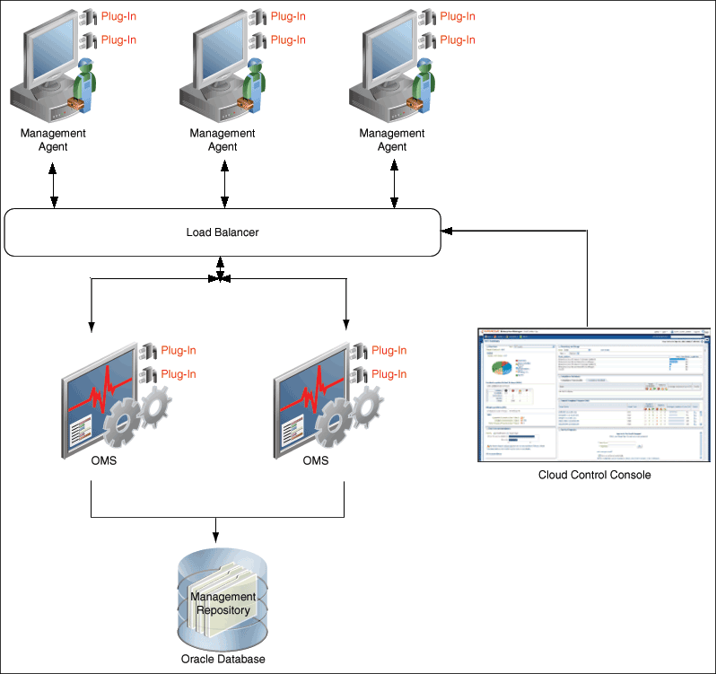
OEM 13c Architecture

Slide 5
OEM 13c Architecture
Enterprise Manager Cloud Control includes the following components:
Oracle Management Agent
OEM agent is software component deployed on each monitored host.
OEM agents are responsible of monitoring all targets running on those hosts and communicating that information to OMS.
Oracle Management Service
OMS is a Web-based application that orchestrates with the Management Agents and the Management Plug-ins to discover targets, monitor and manage those targets, and store the collected information in a repository for future reference and analysis.
Oracle Management Repository
Management Repository is Oracle database.
OMS uploads the monitoring data it receives from the OEM Agents to the Management Repository.

Slide 6
OEM 13c Architecture cont..
Plug-ins
Plug-ins are OEM feature for managing and monitoring Oracle technologies, such as Oracle database, WebLogic, and Oracle Fusion applications.
Default management Plug-ins are
Oracle Database
Oracle Fusion Middleware
My Oracle Support
Oracle Exadata
Enterprise Manager Cloud Control Console
EM console is web based user interface.
With the help of the console, you can monitor and administer your entire computing environment from one location on the network

Slide 7
OEM 13c Agent
OEM agent directories
AGENT_BASE_DIR=/u01/app/oracle/OracleOmsAgent133
Agent Home: /u01/app/oracle/OracleOmsAgent133/agent_inst
Oracle Home=/u01/app/oracle/OracleOmsAgent133/agent_13.3.0.0.0
EMCTL commands for agent management
cd /u01/app/oracle/OracleOmsAgent133/agent_13.3.0.0.0/bin
./emctl status agent
./emctl stop agent
./emctl statart agent

Slide 8
Metric collection and settings
Monitor single target database.
target -> databases -> [database name] -> Oracle Database -> Monitoring -> Metric collection and settings
target -> databases -> [database name] -> Oracle Database -> Monitoring -> All Metrics

Slide 9
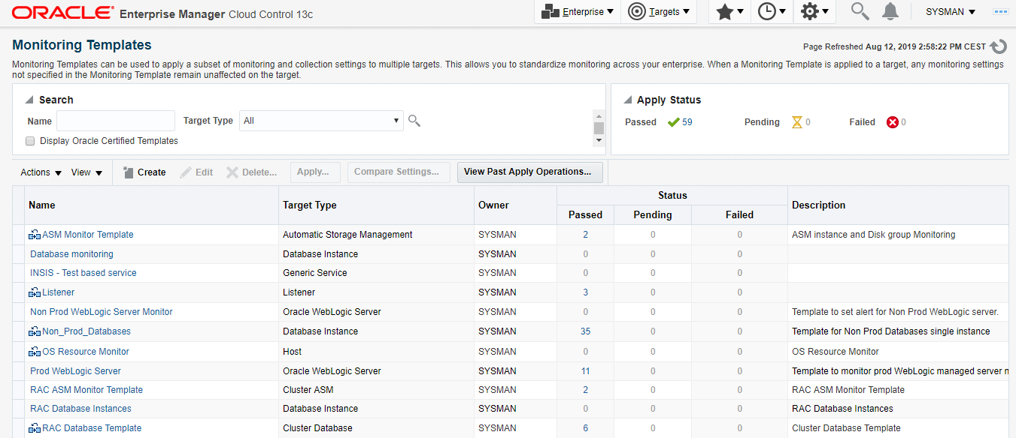
Monitoring templates
Enterprise->Monitoring->Monitoring templates
Monitoring Templates can be used to apply a subset of monitoring and collection settings to multiple targets. This allows you to standardize monitoring across your enterprise. When a Monitoring Template is applied to a target, any monitoring settings not specified remain unaffected on the target in the Monitoring Template.

Slide 10
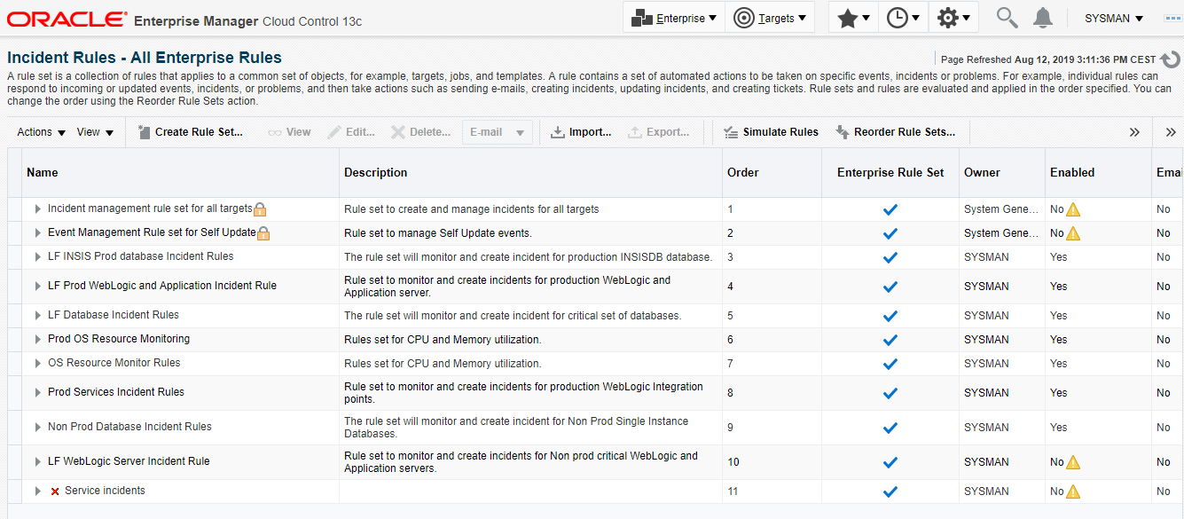
Incident Rules
Setup-> Incidents -> Incident Rules

Slide 11
Target add/Remove
Target Discovery
Setup-> add target-> Auto Target Manually
Remove target from OEM console
Delete target from repository
emcli login -username=sysman -password=**********
emcli sync
emcli delete_target -name="e75lrl2012.lfnet.se:1830" -type="oracle_emd" -delete_monitored_targets
Agent Decommissioning

Slide 12
Notification Blackout Creation

Slide 13
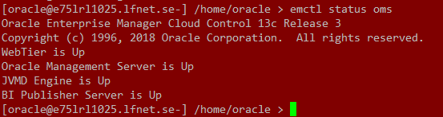
OEM server start, stop, Status
emctl start oms
emctl stop oms
emctl status oms

Slide 14
Known issues

Slide 15
Thank You!!

